Slide 1

Non-Emergency Patient Transport Regulation
For NEPT Providers, Patient Transport Officers and Clinical Escorts
November 2019

Slide 2

Welcome
Housekeeping
Introduction
Overview of new NEPT Regulations
Implementation
Scenarios – group discussion
Questions
Evaluation
Notes:
Housekeeping – site specific
Introduction – speakers – site specific
Session objectives – that the participants will have an understanding of:
The purpose for new NEPT Regulations to:
Ensure consistency of transport services across all NEPT providers
Ensure transport for appropriate non-emergency type patients from one facility to another
Ensure safe, high quality patient transport
2. The Implementation of the NEPT Regulations from 1 December 2019, and the:
Form 10A – Patient Assessment Form (sending facility)
Process for booking NEPT services
Form 10B – Patient Care Record (NEPT services)
Clinical handover requirements using ISBAR methodology between referring and receiving services, NEPT services and/or to Ambulance Tas
3. Typical NEPT scenarios, appropriate scope for NEPT patients, and the legal requirements
group discussion
4. Questions
Evaluation – site specific

Slide 3

New NEPT Regulatory Provisions
Purpose
Outline responsibilities of NEPT Service Providers
  Clinical Governance
Specify quality assurance requirements
  Systems and processes
Define scope of service and patient suitability
Enforcement
Notes:
The Ambulance Service Act 1982 and The Ambulance Service (NEPT) Regulations 2019 provide the legal requirements for ambulance and Non-Emergency patient transport services in Tasmania.
The new Ambulance Service (NEPT) Regulations 2019 commence on 1 December 2019.
The NEPT Service Provider has a responsibility for Clinical Governance for the service to ensure :
quality transport services
quality, maintained vehicles and equipment
qualified staff with appropriate knowledge and skills for Non-Emergency patient transport
risks to patients, staff and the public are appropriately mitigated
The NEPT service provider must have a Clinical Governance Committee in place that is responsible for:
overseeing safety and quality of patient transport and all clinical aspects of patient care
reviewing any critical incidents and complaints
providing advice regarding improvements to the NEPT Service Provider regarding the safety and quality of the service
The NEPT service provider must ensure all quality assurance requirements are in place for:
risk management
staff credentialing and procedures within the staff member’s Scope of Practice
clinical care provision
Infection prevention and control IP&C
vehicles and equipment – maintenance and consumables
incident management and escalation of patient care to Ambulance Tasmania if required
consumer feedback and complaints
staff orientation, ongoing education and training, and performance management
consumer engagement
record keeping,
provision of audits
annual reporting requirements
The scope of NEPT services is for low and medium acuity patients
Patients must be assessed for their suitability
Low acuity patients require basic care and observation
Medium acuity patients require clinical care and monitoring
The NEPT Regulations clarify a standard approach to the assessment of patients’ suitability for NEPT using Approved Forms
Form 10A (for referring facilities) and
Form 10B (for NEPT services)
The NEPT Regulations define the importance of a robust clinical assessment for each patient prior to transportation using NEPT services
The NEPT Regulations stipulate that a clinical escort is required for medium acuity patients, and some of the clinical circumstances
The NEPT Regulations aim to strengthen processes around transport, patient care and clinical handover
Enforcement
The NEPT Regulations allow for provisions for charging licensing fees, and charging infringement notices for breach of the Regulations
The Department of Health’s Regulation Unit will monitor NEPT Services to ensure compliance with the new Regulations and will conduct annual audits at a minimum
This will ensure safe, high quality private NEPT services and help minimise risks to patients

Slide 4

NEPT Services – Safety and Quality
Appropriately trained crew
Can only accept NEPT ‘suitable’ patients
Secretary Approved Forms
Maintain records for each patient transport
Report critical incidents and near misses
Notes:
The NEPT service must have governance systems and processes in place to ensure safe, high quality transport services.
These include that:
The NEPT Crew are appropriately trained with applicable qualifications
Patient Transport Officers must have a minimum of Certificate III in Non-Emergency Patient Transport (or a qualification deemed to be equivalent by the Secretary).
Certificate III in Non-Emergency patient transport includes units on providing first aid, recognising healthy body systems, communicating and working in health or community services, and working with vulnerable people
Clinical Escort can be EN, RN, Registered Paramedic or MP
The clinical escort must be applicable for the acuity of case – to undertake clinical observations, manage indwelling devices (but not IVT which is excluded from scope of NEPT), manage equipment and escalate care if required
The NEPT service can only accept NEPT ‘suitable’ patients who have been assessed by an approved health care professional
The assessment must be undertaken by an approved health care professional using Form 10A, to ensure the patient is suitable for NEPT transport
An approved health care professional is a RN, Registered Paramedic, or a MP
In Residential Aged Care Facilities, an Enrolled Nurse (EN) may commence the assessment using Form 10A, but the assessment must be agreed to and signed by an RN
The assessment must be signed by the assessor, stating that the patient is low or medium acuity, as close to the time that transport is booked as possible
The assessment must be endorsed by the most senior RN in charge and on duty at the facility, or by a MP – agreeing that the patient is low or medium acuity and therefor suitable for NEPT transport
Secretary Approved Forms must be used
Form 10A – Patient Assessment Record – completed by the referring facility/health service
Form 10B – Patient Care Record – completed by the NEPT Service
Form 9 – Incident Report – required and completed by the NEPT Service
Records must be maintained for each patient transport encounter
Form 10A (Patient Assessment Record Form) will come in a book, providing an original Form with 2 carbon copies
The Referring Facility will keep the original From 10A in the patient’s record, and provides the 2 copies to the NEPT crew
The NEPT crew provide a copy of Form 10A to the Receiving Facility, along with a copy of Form 10B (Patient Care Record Form)
The 2 Forms (10A and 10B) are required for clinical handover by the NEPT service to the Receiving Facility and referred to as the ‘Patient Care Record’.
Report critical incidents and near misses
The NEPT service are responsible for recording and reporting critical incidents and near misses to the Department of Health Regulation Unit using Form 9 (Incident Report Form)

Slide 5
NEPT suitable patients:
Definition
NEPT patients are patients
(a) whose medical needs have been assessed by a member of an approved health profession (Registered Nurse, Registered Paramedic or Medical Practitioner) as:
(i) requiring patient transport; and
(ii) not being time-critical or acute;
and
(b) who may require –
(i) basic care and observation; or
(ii) clinical care and monitoring;
(from Ambulance Service Act 1982)
Notes:
The Ambulance Service Act 1982 provides this definition for NEPT suitable patients
NEPT patients are patients
(a) whose medical needs have been assessed by a member of an approved health profession (RN, Registered Paramedic or Medical Practitioner [MP]) as –
(i) requiring patient transport; and
(ii) not being time-critical or acute; and
And (b) who may require –
(i) basic care and observation; or
(ii) clinical care and monitoring;
The new Regulations distinguishes criteria for low and medium acuity patients:
Criteria for all low/medium acuity patients:
Must be at least 2 years of age
Must not be acute or time-critical
Is unlikely to deteriorate while using NEPT
vital signs must be stable and normal for person
Must not have had recent deterioration in respiratory rate as a result of a diagnosed illness or disease
Low Acuity Patient – must not be a paediatric (must be older that 14 years) and requires basic care and observation
Medium Acuity Patient - can be a paediatric (between 2 – 14 years); will require some clinical care and monitoring, and therefore will require a clinical escort to take clinical observations; and document on the Patient Care Record – Form 10B.
For avoidance of doubt, medium acuity includes:
Paediatrics >2 < 14years
oxygen therapy (if established prior to NEPT services and the patient is stable on it)
A patient that requires active monitoring – ie: ‘cardiac monitoring’ to assess a patient’s cardiovascular status, not cardiac rhythm (this would be outside of NEPT scope for low and medium acuity patients)
High Acuity Patient – is acute and/or time-critical – and therefor not suitable for NEPT

Slide 6
Low Acuity / Medium Acuity
All patients must be stable:
Not time critical or acute
Not likely to deteriorate during transport
Have NOT had recent deterioration in respiratory rate as a result of a diagnosed illness or disease
Low Acuity
Not a paediatric (14 years or older)
Require only basic care and observation
Medium Acuity
Can be a paediatric (between 2 - 14 years)
Requires clinical care and monitoring
by a clinical escort
Notes:
Low Acuity
Not a paediatric (14 years or older)
Require only basic care and observation
Stable Not time critical or acute
Not likely to deteriorate during transport
Have NOT had recent deterioration in respiratory rate as a result of a diagnosed illness or disease
Medium Acuity
Can be a paediatric (Between 2 - 14 years)
Requires clinical care and monitoring – clinical escort

Slide 7
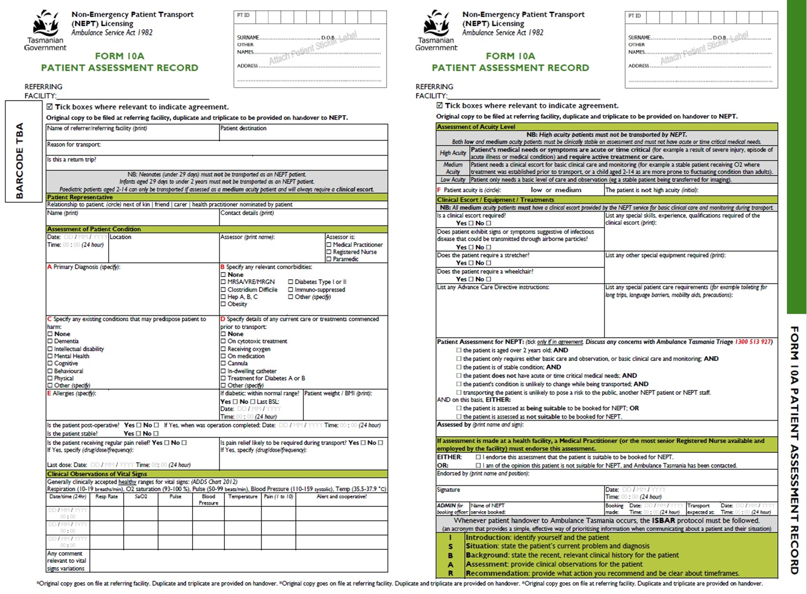
FORM 10A
PATIENT ASSESSMENT RECORD
FORM 10A
PATIENT ASSESSMENT RECORD

Slide 8

Patient Assessment – Referring Facility
Patient suitability - is a clinical escort required?
Likely patient’s needs on-route
Likelihood of patient deterioration
Likelihood of any unforeseen risks
Notes:
Referring facility responsibilities
Form 10 A Patient Assessment
Must be undertaken by an approved health professional – (MP, RN or Registered Paramedic) to determine whether NEPT is suitable and assess for low or medium acuity
The assessment requires critical thinking about the patient’s suitability and clinical needs during transport.
consider the reason for transport, their comorbidities, existing conditions, current care and treatments, are they post-op, are they stable, is their pain under control, are there any language barriers, what is their cognitive state, are they mobile, are there any precautions for this patient?
is a clinical escort is required, and does the clinical escort need specific knowledge and skills?
Is there any clinical requirements that require care, monitoring, observations, and documentation?
is any specific equipment required?
What is the likelihood of the patient deteriorating based on their current clinical status, and progress last few days?
Are there any unforeseen risks to consider ie: what if held the NEPT vehicle was held up in traffic … is patient likely to require pain relief?
If patient is palliative – Need to consider if Advanced Care Directive is in place or not? If the patient arrested in transit … should the crew undertake CPR?
Endorsement of Patient Assessment Record
Level of responsibility *
Only a MP or the most Senior RN employed by and available at the facility can clinically endorse an assessment undertaken on a patient as suitable for NEPT.

Slide 9
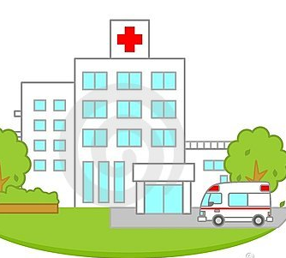
Booking process - private patient in a private facility
Private patient in a private facility (HSE / Residential):
Low or medium acuity - private NEPT
Any question re acuity - discuss with AT (HTSCC)
If assessed as borderline medium / high - transfer by AT
Notes:
Private Patient in a private HSE
Low and medium acuity patients MUST NOT BE acute or have time-critical medical needs
Low acuity can be transported by qualified PTOs
therefore the patient MUST BE clinically stable and unlikely to deteriorate on-route, 14 years or older & only require a basic level of care and observation
Medium patient can be transported by PTO with a clinical escort.
Patient MUST BE > than 2 yrs & be clinically stable
A medium acuity patient may have additional comorbidities, existing conditions, or had treatments that require low level clinical care and/or observation
MUST HAVE a clinical escort (EN, RN, Registered Paramedic, or MP) with the knowledge and skill required to provide clinical care (within SOP), document appropriately, accompany the PTO and handover using ISBAR to receiving facility.
If any question re acuity – discuss with AT’s Health Transport Service Co-Ordinator Centre HTSCC 1300 513 927
If agreed medium – transfer by private NEPT with clinical escort
If assessed as borderline medium/high acuity – transfer by AT
Refer to NEPT BOOKING FLOWCHART

Slide 10
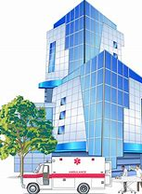
Booking process - public patient in a private facility
Public patient in a private HSE
Low or medium acuity
Complete NEPTA online booking form
AT NEPT resources assessed
  Transfer by AT NEPT
  Referred to private NEPT
Notes:
Public Patient in a private HSE
Low and medium acuity patients MUST NOT BE acute or have time-critical medical needs
Complete NEPT booking form – (and fax/email booking form to HTSCC Health Transport Service Coordination Centre (1300 513 997)
AT resources assessed for availability, and if available scheduled for transport with AT NEPT
If AT resources unavailable, and transfer time can not be changed to next available AT resource, permission must be approved by relevant THS facility to transfer patient by private NEPT
Refer to THS Contact’s Chart
If THS approves transfer by private NEPT – book private provider
If not approved by THS, alternate AT NEPT times need to be explored or alternative transport options considered.
If a private NEPT service is engaged, a completed Form 10A must be completed and provided to the private NEPT crew.

Slide 11

Patient handover from referring facility to private NEPT
There must be a verbal patient handover from the referring facility that is to the satisfaction of the NEPT crew member
ISBAR
The NEPT crew must be provided with a copy of the Patient Assessment Form (Form 10A)
Notes:
1. Introduction – identify yourself and the patient
2. Situation – state the patient’s current problem, their diagnosis and reason for NEPT
3. Background - State the recent, relevant clinical history in accordance with the patient assessment - Form 10 A and provide copy
4. Assessment – discuss most recent clinical observations
5. Recommendations – discuss actions required and timeframes.
RN providing patient handover should handover to the clinical escort for medium acuity patients.
For low acuity patients, RN will consider the Scope of the receiving Patient Transport Officer to ensure understanding of relevant clinical information.
PTO must feel comfortable with the information provided during the patient handover.

Slide 12
Form 10A Assessment Handover to NEPT crew
Crew need to check:
  A. Patient’s Diagnosis
  B. Relevant comorbidities
  C. Existing conditions
  D. Current care or treatments
  E. Allergies
  F. Patient acuity level
And copy details to Form 10B (Patient Care Record)
AND still believe that the patient is still NEPT suitable.
Notes:
Form 10A Assessment – Undertaken by approved health professionals at health facilities – Registered Nurse, Medical Practitioner, Registered Paramedic
On handover, when the NEPT crew accepts a patient for transport, they must commence Form 10B the patient care form, which requires them to check the patient assessment form (Form 10A) and note agreement/comments on Form 10B.
The referring facility will book the patient in with the NEPT Service Provider (so another check here to ensure NEPT suitability).
It must be determined at this point, if a clinical escort is required and if there is any special equipment needs.
The NEPT service must maintain records, for evidence of the booking and conversation – SYSTEM & PROCESS
NEPT crew need to ensure:
Patient is stable
Not acute OR time critical
Does not require higher level clinical services (ie: medical care for deterioration in condition / abdo pain FI for example)
Should all have been assessed and endorsed by referring facility, but important to remember that NEPT patients should:
not have indwelling intravenous devices (except IV cannula)
not require ECG monitoring
not have any infectious diseases
not be a psychiatric patient
Not be on cytotoxic therapy / or immunosuppressed – must not travel with another patient
not require spinal precautions
not have had narcotic medication within last 30 minutes – 1 hour
Not require medication during transport (unless low level analgesia provided by clinical escort)

Slide 13

NEPT Crew assessment
NEPT crew must ensure patient is:
  Stable, and low or medium acuity
  Not acute of time critical, and unlikely to deteriorate
  There is no risk to patient or crew
Documents on Form 10B (Patient Care Record)
  Transport Details / Patient Representative Details
  Crew members
  Patient history / Clinical Assessment Record
Notes:
NEPT crew need to ensure: (2 scopes of practice – Clinical Escort / PTO)
Patient is stable
patient is low or medium acuity
Not acute OR time critical
unlikely to deteriorate
Transport poses no risk to patient or crew
If a clinical escort or special equipment required, this should have already been determined when the booking was made.
NEPT crew need to agree the following have been documented:
Patient personal details
Patients under 2 years of age must not be transported by private NEPT. Child patients aged 2-14 years may be transported if NEPT suitable but will always require a clinical escort.
Patients representative
Assessment of patient’s condition. Is patient stable? Is patient alert and co-operative?
Primary diagnosis
any relevant co-morbidities
Infectious diseases – patients with MRSA, VRE, MGNB, C Diff etc.. Can be transported using NEPT if they are stable, not likely to deteriorate, and will not pose a risk to NEPT crew. If will pose a risk, the patient is not appropriate for NEPT
NEPT crew must comply with infection prevention and control and undertake standard and transmission based precautions in accordance with policy's and procedures
Patient’s having cytotoxic treatments may be immunosuppressed, so must not be transported with other patients.
Diabetic patients may require food or fluids for longer trips
Ensure patients who are obese will not pose a risk to NEPT crew.
Existing conditions that may predispose patient to harm - physical, behavioural, mental, cognitive Current care or treatment - oxygen, medications, IV cannula, IDC, drains, treatments for Diabetes
Allergies
8. If patient is post-operative, how long since operation? RPAO must be completed prior to consideration for NEPT
9. Is patient in pain? if so, has pain relief been provided? (Record time of last analgesia when ready to transport).
Patients should be alert and cooperative so can carry their own medications, and self administer if required.
10. Are there any abnormalities in vital signs (differing from normal for the patient)?
RR and effort (*Important criteria), SpO2, HR, BP, Temp.
These readings may indicate patient is unstable and not suitable for NEPT.
11. Is patient low or medium acuity? .
12. Is the patient palliative… review requirements. ACD must stay will patient.
Clinical handover details receiving facility
13. Is there any evidence of an infectious disease that would pose a risk?
14. any other special requirements which must be taken into account?
special skills required of clinical escort/special equipment required in NEPT vehicle.
15. Does the final tick box section on Form 10A for patient assessment for private NEPT satisfy requirements for NEPT suitability? This is a requirement and this section can only be signed by a MP or RN or Registered Paramedic.
16. If assessment is carried out at a health facility has Form 10A been endorsed as required?
17. If the patient’s medical needs or symptoms are acute or time critical (eg a result of severe injury, episode of acute illness or medical condition) and require active treatment or care, they are high acuity and therefore not NEPT SUITABLE.

Slide 14
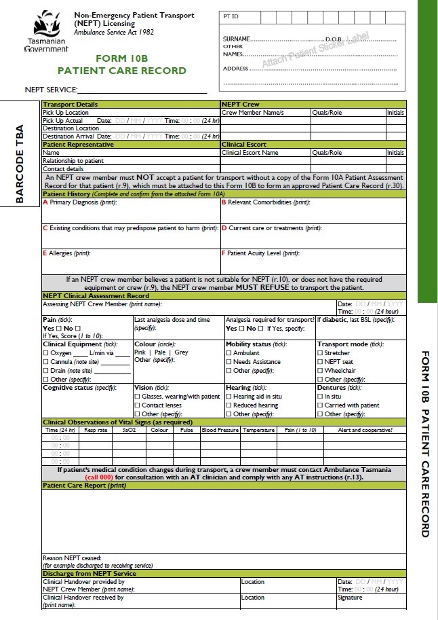
Sample of Form 10B
FORM 10B
PATIENT CARE RECORD

Slide 15
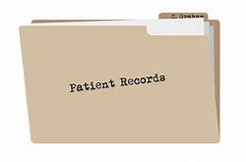
NEPT record keeping responsibilities
NEPT services must keep:
records of the booking and conversation with the referring facility
AND copies of:
the Patient Assessment Form they receive from the referring facility (Form 10A)
the Patient Care Record (Form 10B) they complete
AND the crew must provide copies of Forms 10A and 10B to the receiving facility, or AT if patient is transferred to AT
Notes:
NEPT services must keep records of:
the booking and conversation with the referring facility
copies of the Patient Assessment Record from the referring facility (Form10A), plus the completed Patient Care Record (Form10B)
The crew must provide copies of Form 10A and 10B to:
the receiving facility
the facility providing an appointment
Ambulance Tas if patient is transferred to the care of Ambulance Tas

Slide 16

Clinical Escorts
Required for all medium acuity patients (and all child patients aged 2-14 years)
The clinical escort will:
Provide clinical care and monitoring
Receive and provide clinical handover regarding the patient using ISBAR
Complete documentation
Support patient transport officer
Notes:
Clinical escorts are required for all medium acuity patients (and all child patients aged 2-14 years)
A clinical escort is crew member who is an EN, RN, Registered Paramedic or a MP.
The clinical escort must posses the knowledge and skills required to provide clinical care and monitoring (ie observations) on-route (within their scope of practice)
The clinical escort will:
Provide clinical care and monitoring (observations)
receive and provide clinical handover regarding the patient using ISBAR
Complete documentation
Support patient transport officer

Slide 17

NEPT crew must refuse transport
If the patient is not NEPT suitable
If the crew does not meet the clinical escort requirements
If specific equipment is required and can’t be provided
If transport would pose a risk to the health and safety of patient/crew/public
Notes:
Where there is any doubt that the patient does not meet the low/medium acuity criteria, they MUST refuse to transport.
This includes where the NEPT crew does not consider:
the patient to be NEPT suitable eg. patient’s condition has changed since assessment and no longer low/medium acuity but higher acuity
If the crew does not meet the clinical escort requirements, such as qualification (EN, RN, Registered Paramedic, MP) or posses specific skills or experience (as noted on Form 10A)
If any specific equipment is required and can not be provided
If transport would pose a risk to health/safety of patient/crew/public
and this information was not handed over.

Slide 18
Patient handover to receiving facility or AT
There must be a verbal patient handover from the NEPT crew to the receiving facility
The receiving facility must be provided with a copy of the:
  Patient Assessment Form (Form 10A) and
  Patient Care Record (Form 10B)
Notes:
Introduction – identify yourself and the patient
Situation – state the patient’s current problem, their diagnosis and reason for NEPT – Form 10B
Background - State the recent, relevant clinical history in accordance with the patient assessment - Form 10 A provide copy
Assessment – discuss most recent clinical observations / if patient is palliative ACD
Recommendations – discuss actions required and timeframes.
Any Critical incidents during NEPT :
Injury or harm that results in patient requiring extra supervision or medical treatment
An event that results in foreseeable risk of either of these

Slide 19

Reportable Incidents - Form 9
Critical incident:
  patient death OR
  injury or harm that results in patient requiring extra supervision
  or medical treatment OR
  an event that results in foreseeable risk of either of these.
NEPT vehicle in traffic accident during NEPT
Patient was transferred to AT
Assistance was provided to the patient under the direction of AT
Warning lights were used
Notes:
Reporting of incidents
Any reportable incident must be reported to the Secretary orally as soon as practicable after the incident and within two business days of the incident occurring,
the Secretary must be provided with a completed Incident Report Form (Form 9) with Forms 10A (patient assessment) and 10B (patient care record) attached.
Reportable incidents are:
Critical incident (patient death/injury or harm that results in patient requiring extra supervision or medical treatment/an event that results in foreseeable risk of either of these)
2. NEPT vehicle involved in traffic accident during NEPT
3. Patient was transferred to AT
4. Assistance was provided to the patient under direction of AT
5. Warning lights were used
Where the incident was life-threatening or fatal, the patient’s next-of-kin or patient representative(family member/carer/registered health practitioner nominated by patient) or patient legal representative must be orally notified as soon as practicable after the incident.

Slide 20
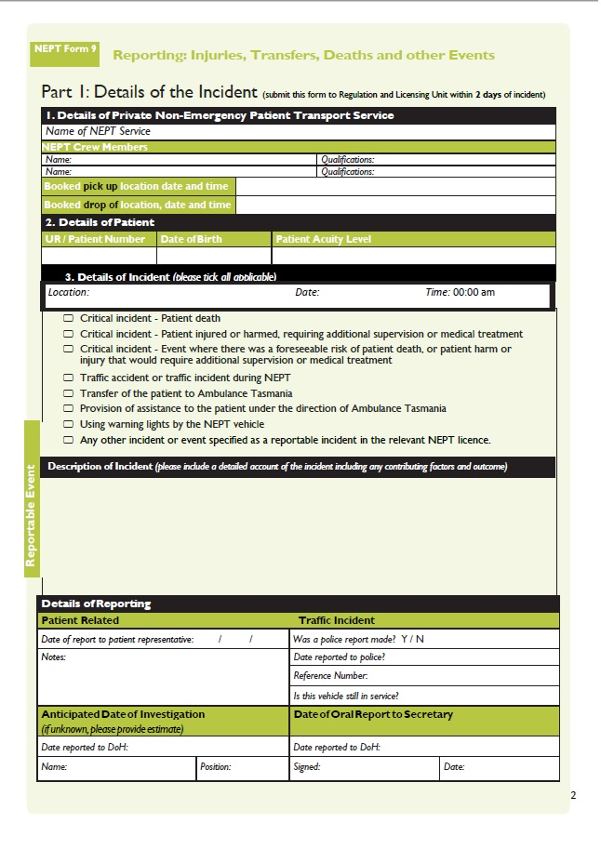
Slide 20
FORM 9
REPORTABLE INCIDENT FORM

Slide 21
Scenarios – Group Instructions
Work through assessment criteria – use checklist tool
Determine the patient’s acuity level, any special equipment needs, clinical escort requirements
Determine the booking process for the patient – NEPT service, how to book, pick-up times etc
Identify any issues for clinical handover
Consider your facility's interhospital transfer requirements, other documents - patient records, xrays etc
Notes:
Work through assessment criteria – consider using the ‘checklist tool’ with information from Form 10A Patient Assessment Form
Determine acuity level, special equipment needs, clinical escort requirements
Work through booking process for each scenario – the NEPT service (Private/public patient), booking form/process, pick-up times
Identify any issues in preparation for clinical handover
Determine/consider your facilities interhospital transfer requirements – are you familiar with the form?, patient records that need to be sent with the patient

Slide 22

Slide 22
Comments / Issues
Evaluation
Email: nept@health.tas.gov.au
Website: www.dhhs.tas.gov.au/nept
Notes:
Evaluation – site specific

